Slide 1
CONCEPTS OF DOCUMENTATION AND TITLING

Slide 2
DOCUMENTATION according to Cambridge Dictionary:
----> official or legal documents that are needed in order to prove something
----->the activity of recording facts relating to a particular subject:

Slide 3
1.THE ABILITY TO CRAFT A LEGAL DOCUMENT
NOTES: a) Do no rely on google.com alone
b) Keep on reading ( comprehension is a must)
c) Think of the requirements of the BIR and Administrative Bodies/Courts
---> Who will be responsible to pay the
taxes, transfer fees, and legal fees?
d)Secure a certified copy of the Title and/or Latest Tax Declaration

Slide 4
e)Make sure that it would be notarized(check that the Notary Public is an active Member of the IBP,research also from the Supreme Court website)
ASK YOURSELF THIS QUESTION: WHAT DOCUMENT AM I GOING TO DRAFT?
Hint: The simplier, the better.

Slide 5
COMMON DOCUMENTS NEEDED BY CLIENTS:
1.Authority to Sell (Exclusive or non-exclusive)
2.Special Power of Attorney
3.Waiver/ Affidavit of Waiver/Affidavit of two(2) Disinterested Persons/Affidavit of Loss
4.Deed of Conditional Sale/ Contract to Sell
5.Deed of Sale (with or w/o furniture and fixtures)
6.Extra-judicial Partition/Extra-Judicial Settlement of Estate

Slide 6
7.Deed of Donation(Absolute or Conditional)
8.Lease with Option to Purchase
9.Lease-Purchase Agreement
10.Deed of Sale with Assumption of Mortgage
11.Deed of Undertaking
12.Memorandum of Agreement/Memorandum of Understanding (MOA/MOU)

Slide 7
2.Check the requirements of the BIR for payment of CGT and DST. The deadlines of paying the taxes. Extension to pay taxes with this COVID-19 mess
BASIC:
a)TIN of the parties
b) Latest TD
c) DOS/Deed of Transfer
d) Certified True Copy of Title
e)Certificate of No Improvement

Slide 8
3. The requirements of the LOCAL TREASURER’S OFFICE. Show the E-CAR from BIR. Tax Clearance requirements:
(a) photocopy of Tax Declarations ( Land , Improvement / Building, Condominium, Parking[if applicable])
(b) Original copy and (1) photocopy of the Deed of Absolute Sale
(c) Official Receipt of Payment of Real Property Tax and Special Education Fund Tax for the current year

Slide 9
4. The requirements of the Register of Deeds (For New Title, CCT)
(1) Original Copy & (3) photocopies of the Deed of Absolute Sale, stamped as received by the BIR
Seller’s Owner’s Duplicate Copy of the TCT or CCT
(1) Original Copy of the E-CAR
(1) Original Copy of the Tax Clearance
Original Copies of Official Receipts of Payments of CGT, DST, Tax Clearance Certificate, and Transfer Fee

Slide 10
Original Copies of the Current Tax Declaration for land and improvement issued by the local assessor’s office
If the seller or buyer is a corporation, submit the following requirements:
(a) Secretary’s Certificate authorizing the sale of the real property
(b) Certified True Copy of the Articles of Incorporation and By Laws of the seller or buyer corporation

Slide 11
5. For the release of the new Tax Declaration (Assessor's Office), present a photocopy of the following documents:
DOS
TCT OR CCT
E-CAR
Transfer Tax Receipt
Latest Tax Receipt OR Tax Clearance
Additional documents may be required:
Subdivision Plan, if lot is subdivided
Full-color photos of the house, lot, or condominium unit

Slide 12
6.Administrative Agencies’ requirements(DENR,DAR,NICP/ Regional Trial Court)
Concept is CONNECTION OF DOCUMENTS

Slide 13
THE FOLLOWING SLIDES ARE COURTESY OF DENR

Slide 14
Major Land Administration and Management Laws in the Philippines
CA 141 - Public Land Act of 1936
Act 1120 – Friar Lands Act of 1903
Act 2259 – Cadastral Act of 1903
RA 6657 – Comprehensive Agrarian Reform Law (CARL) of 1987
RA 10023 - Residential Free Patent of 2010
KNOWLEDGE
VALUATION
MAPPING
MANAGEMENT
REGISTRATION
TITLING
SURVEYING

Slide 15
Other Key Legislation and Mandates on Land Administration and Management
Act 496 – Land Registration Act of 1902
PD 1529 – Property Registration Decree of 1978
RA 7160 – Local Government Code of 1991
RA 8371 – Indigenous People’s Rights Act of 1997
KNOWLEDGE
VALUATION
MAPPING
MANAGEMENT
REGISTRATION
TITLING
SURVEYING

Slide 16
Classification of Lands
As to ownership
1. Private lands - those which are titled
2. Public lands - those which are not titled as well as lands of the public domain or outside the commerce of men (roads, public plaza, rivers)
KNOWLEDGE
VALUATION
MAPPING
MANAGEMENT
REGISTRATION
TITLING
SURVEYING

Slide 17
PUBLIC LANDS
Timberland/Forest lands
Non-Alienable and/or Non-Disposable Lands
Alienable and/or
Disposable Lands
Mineral Lands
National
Parks
Agricultural Lands
Non-Agricultural Lands
Homestead
Patent
Free Patent
Sales
Patent
Lease
Reservation
Free Patent Residential
Public and/or Semi-Public
Town Site

Slide 18
MODES OF ACQUIRING TITLES
Administrative proceeding
Patents (DENR)
Certificate of Land Ownership Award (DAR)
Certificate of Ancestral Domains Title (NCIP)
Judicial proceeding (Court)
Decrees under judicial registration (PD 1529)
KNOWLEDGE
VALUATION
MAPPING
MANAGEMENT
REGISTRATION
TITLING
SURVEYING

Slide 19
Modes of acquiring public lands
Public Land Act (CA 141)
1. Free patent (Administrative Confirmation of Imperfect Title)
2. Homestead patent
3. Sales patent
4. Lease
5. Judicial Confirmation of Imperfect Title
6. Special Patent
Republic Act 10023
1. Residential Free patent
KNOWLEDGE
VALUATION
MAPPING
MANAGEMENT
REGISTRATION
TITLING
SURVEYING

Slide 20
Terms to understand
Confirmation of an imperfect title
In Free Patent, DENR does not grant title but it only confirms or affirms the title of the applicant who acquired vested right on the land by virtue of his 30 years possession thereof.
KNOWLEDGE
VALUATION
MAPPING
MANAGEMENT
REGISTRATION
TITLING
SURVEYING

Slide 21
Adverse Possession (OCEN) is not applicable if the land is:
1. Public Lands not subject to Disposition (Timber, National Park, Civil or Military Reservations)
2. Private Land that has been disposed and Registered under the Torrens System (Titled Lands)
KNOWLEDGE
VALUATION
MAPPING
MANAGEMENT
REGISTRATION
TITLING
SURVEYING

Slide 22
Republic Act 9176
An Act extending the period until December 31, 2020, for the filing of applications for administrative legalization (Free Patent) and judicial confirmation of imperfect and incomplete titles to alienable and disposable lands of the public domain, amending for this purpose, Commonwealth Act 141, as amended.
KNOWLEDGE
VALUATION
MAPPING
MANAGEMENT
REGISTRATION
TITLING
SURVEYING

Slide 23
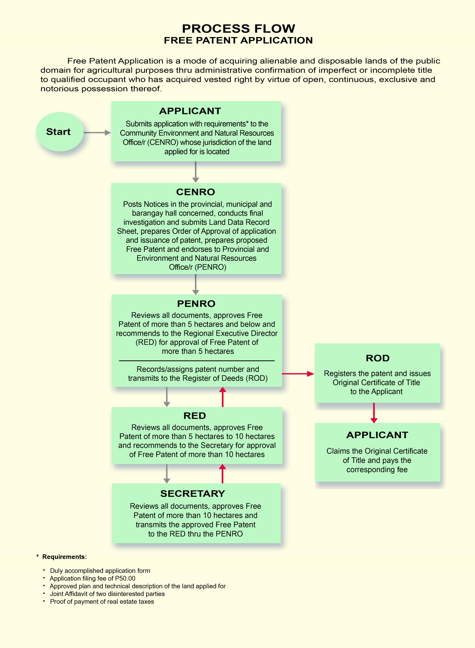
KNOWLEDGE
VALUATION
MAPPING
MANAGEMENT
REGISTRATION
TITLING
SURVEYING

Slide 24
REQUIREMENTS
Homesteader must cultivate at least 1/5 of the land within 6 months from the date of approval of the application.
He must reside continuously for at least one year in the municipality where the land is located.
KNOWLEDGE
VALUATION
MAPPING
MANAGEMENT
REGISTRATION
TITLING
SURVEYING

Slide 25
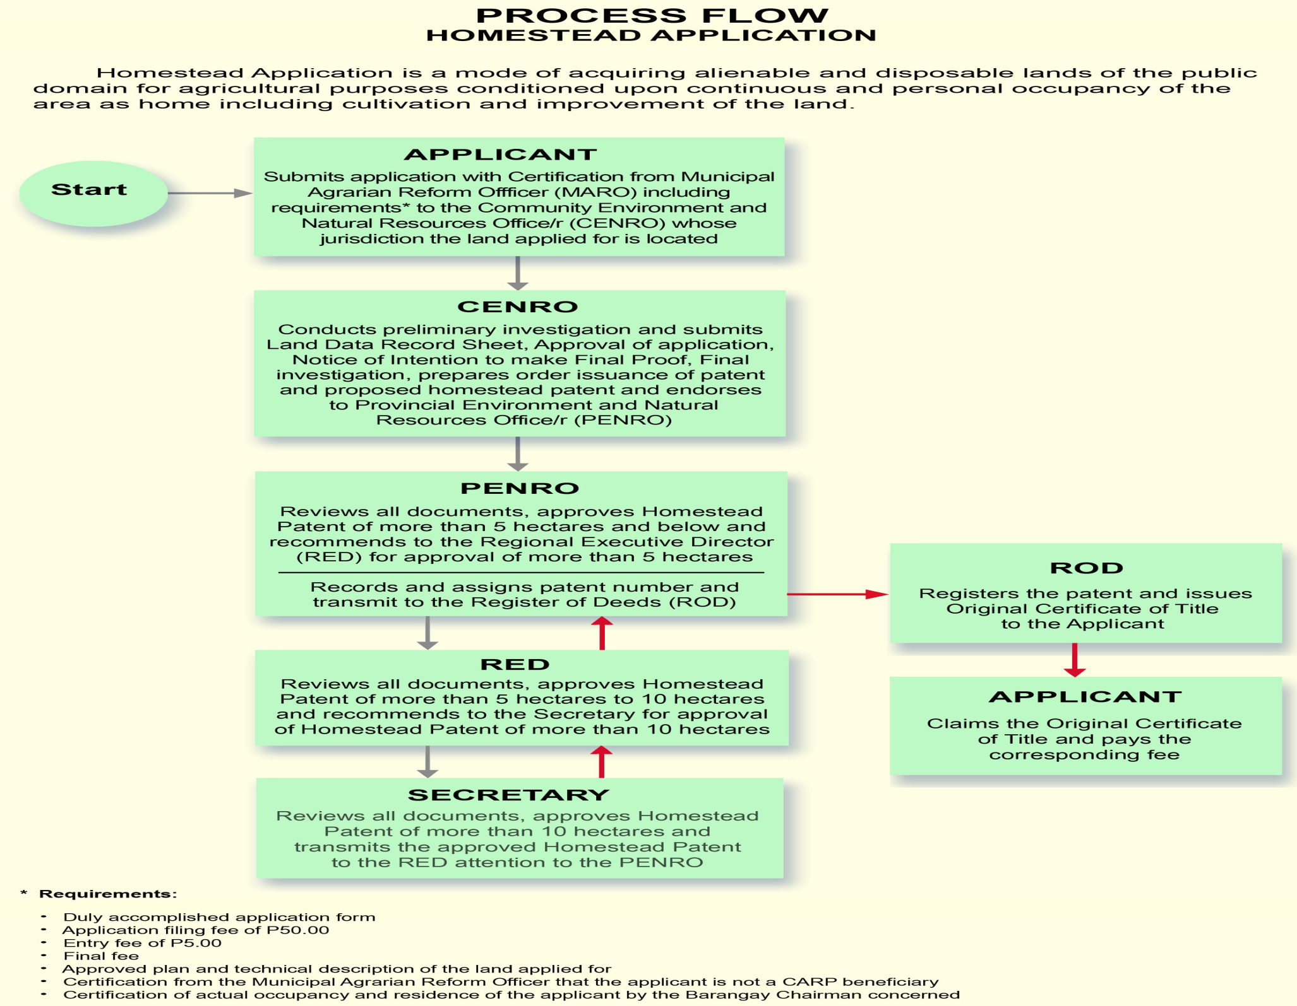
KNOWLEDGE
VALUATION
MAPPING
MANAGEMENT
REGISTRATION
TITLING
SURVEYING

Slide 26
Qualification of Applicants
QUALIFICATION | FREE PATENT | HOMESTEAD
AGE | none | 18 yrs. Or head of family
CITIZENSHIP | Natural born | Filipino
LANDHOLDINGS | 12 hectares | 5 hectares
OCCUPATION | 30 yrs. | 1 year
CULTIVATION | Fully-cultivated | 1/5 of the land (within 6 months)
KNOWLEDGE
VALUATION
MAPPING
MANAGEMENT
REGISTRATION
TITLING
SURVEYING

Slide 27
SALES PATENT
Is a patent issued for the type of application covering lands of the public domain for agricultural purposes as stipulated in Chapter V of the Public Land Act and sold at public auction thru sealed bidding.
While under Chapter IX, it pertains to Classification and Concession of Public Lands Suitable for Residence, Commerce and Industry (Lease and Sale)
Republic Act. No. 730 Direct Sale of Residential Lands without Public Bidding
KNOWLEDGE
VALUATION
MAPPING
MANAGEMENT
REGISTRATION
TITLING
SURVEYING

Slide 28
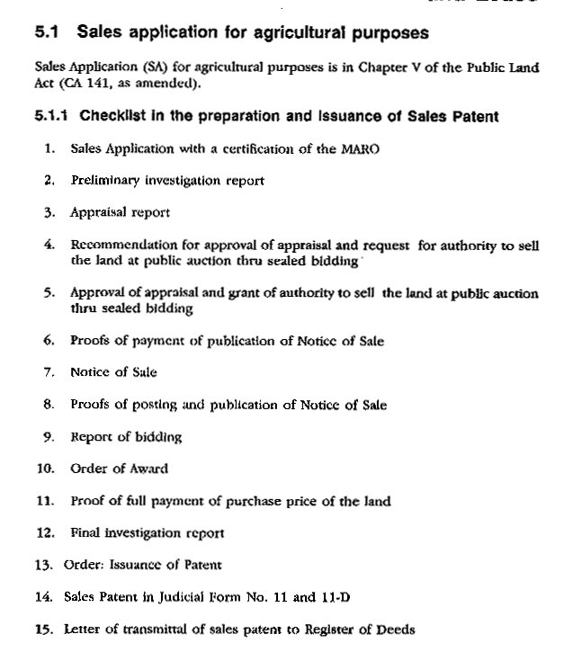
KNOWLEDGE
VALUATION
MAPPING
MANAGEMENT
REGISTRATION
TITLING
SURVEYING

Slide 29
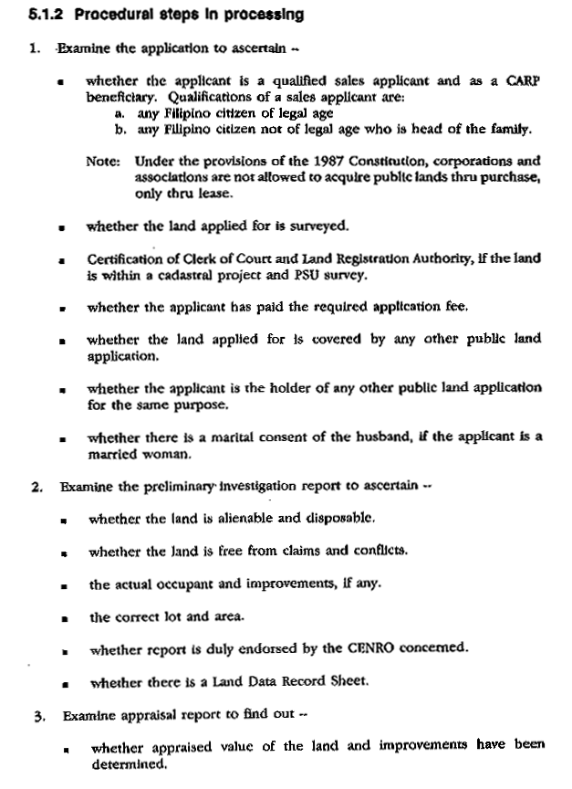

Slide 30
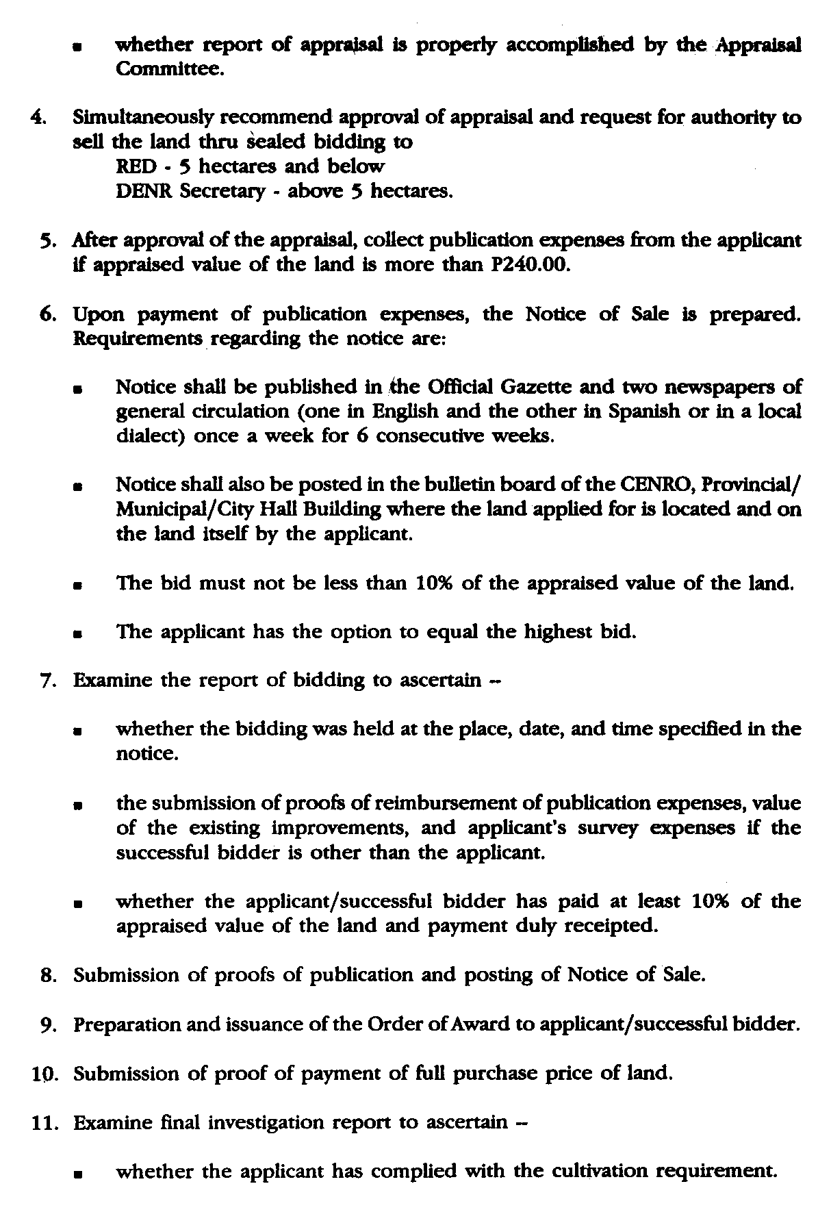

Slide 32
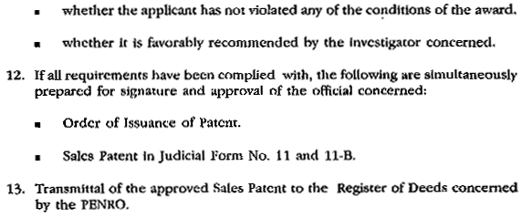
KNOWLEDGE
VALUATION
MAPPING
MANAGEMENT
REGISTRATION
TITLING
SURVEYING

Slide 33
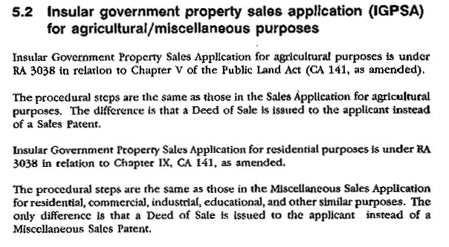

Slide 34
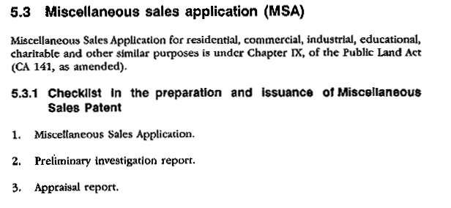
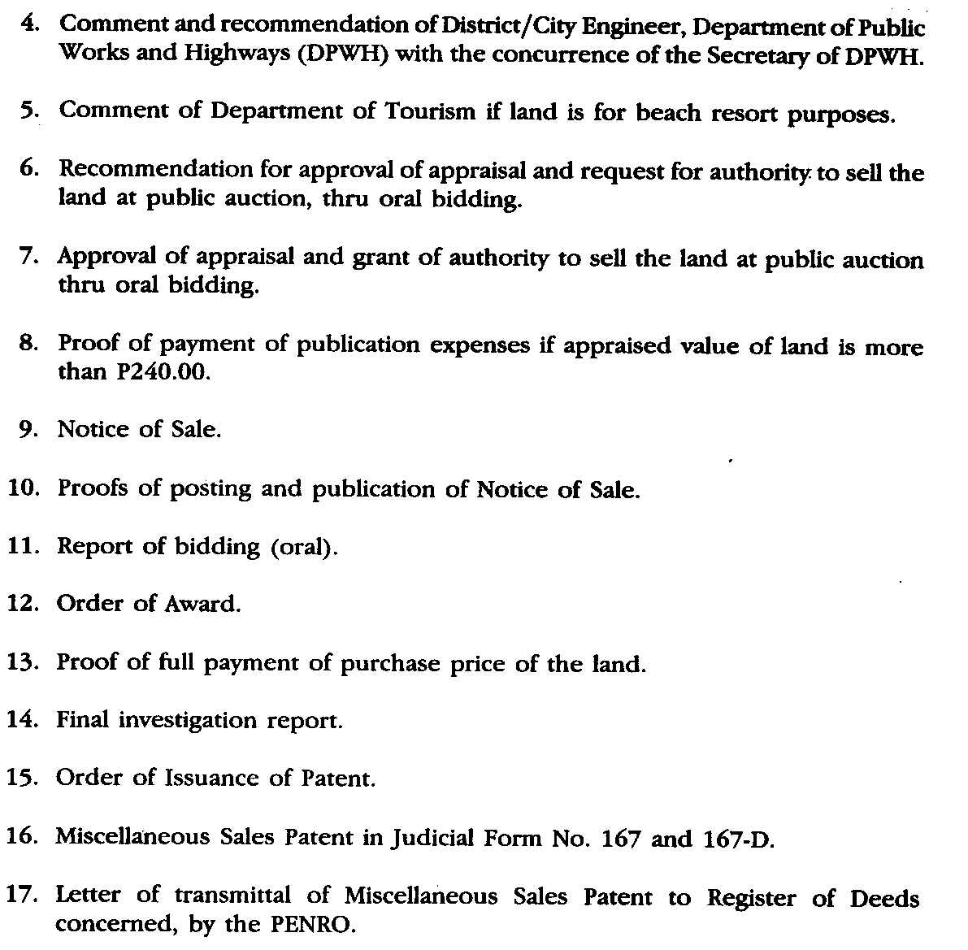

Slide 35
KNOWLEDGE
VALUATION
MAPPING
MANAGEMENT
REGISTRATION
TITLING
SURVEYING

Slide 36
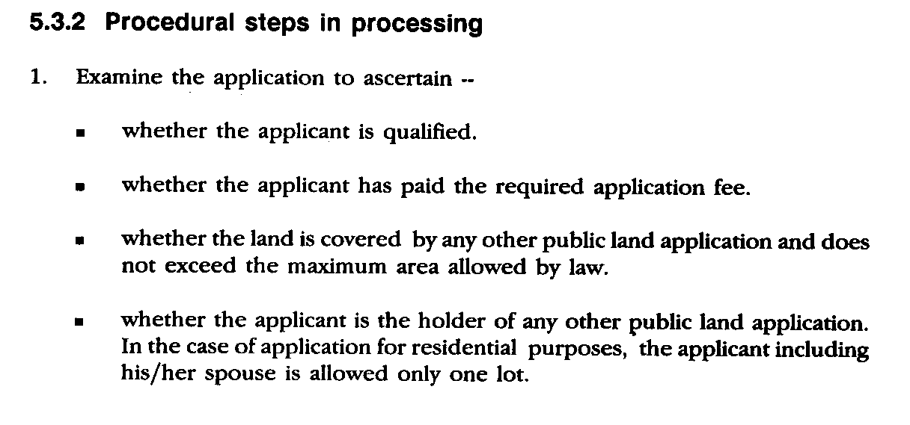
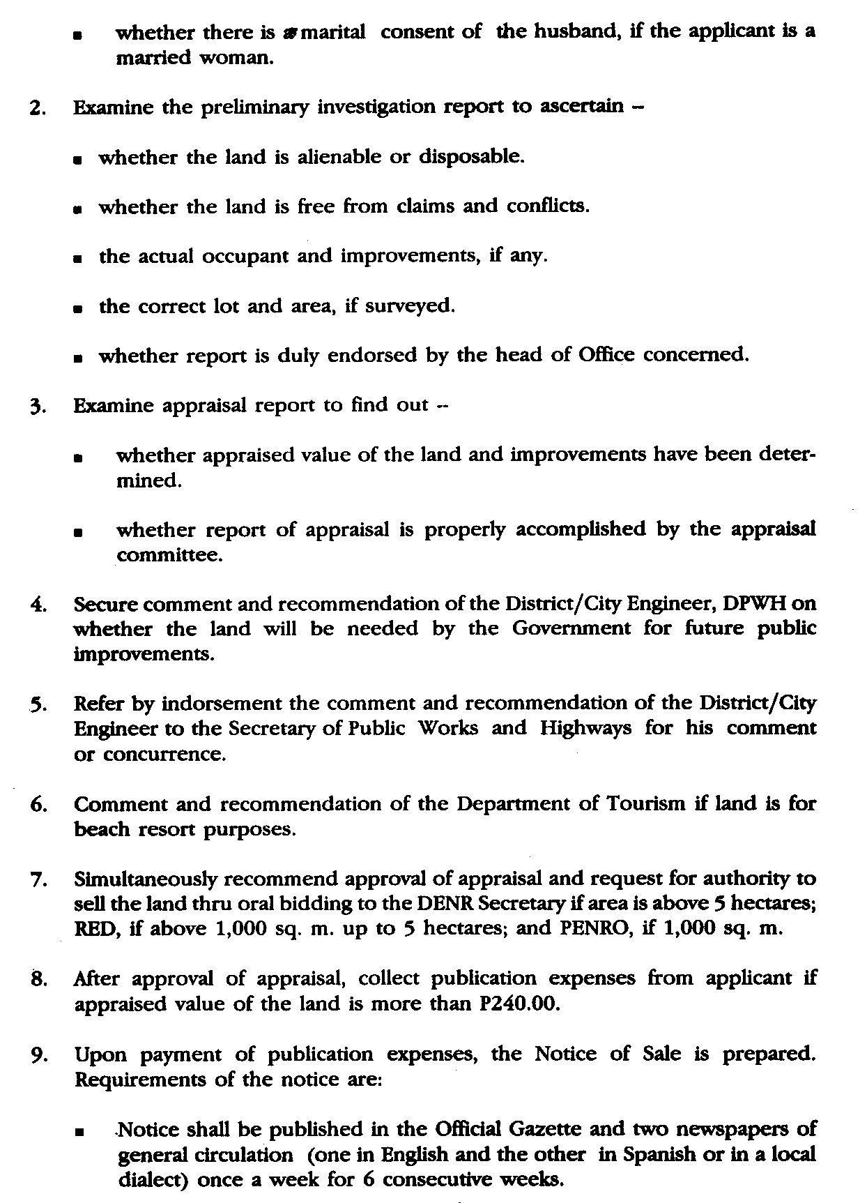

Slide 38
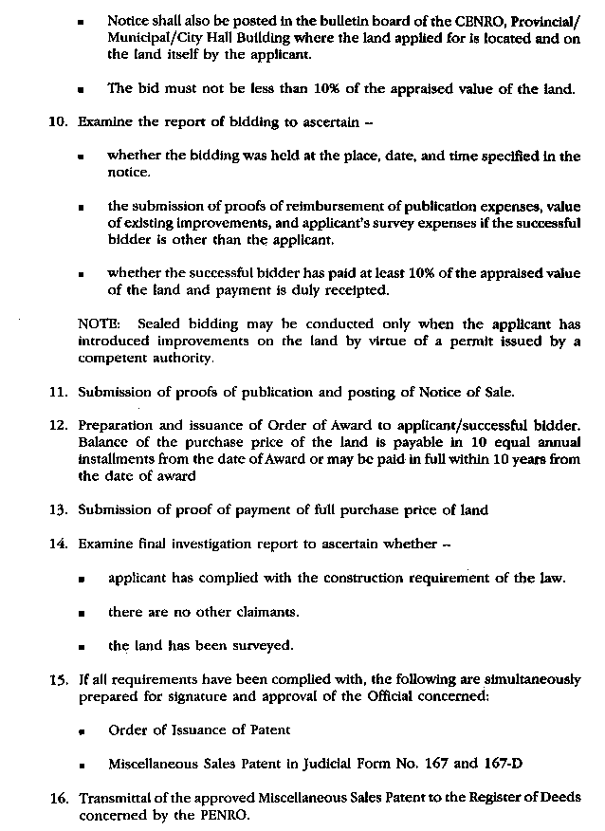

Slide 40
Sales Patent
1. Miscellaneous Sales Application under Chapter IX (For Residential, Commercial, Industrial, Religious and Educational Purposes)
- Public Bidding
2. Miscellaneous Sales Application under R.A. 730 (For Residential Purposes)
1,000 Sq. meters and below - Direct Sale
More than 1,000 Sq. meters - Public Bidding
KNOWLEDGE
VALUATION
MAPPING
MANAGEMENT
REGISTRATION
TITLING
SURVEYING

Slide 41
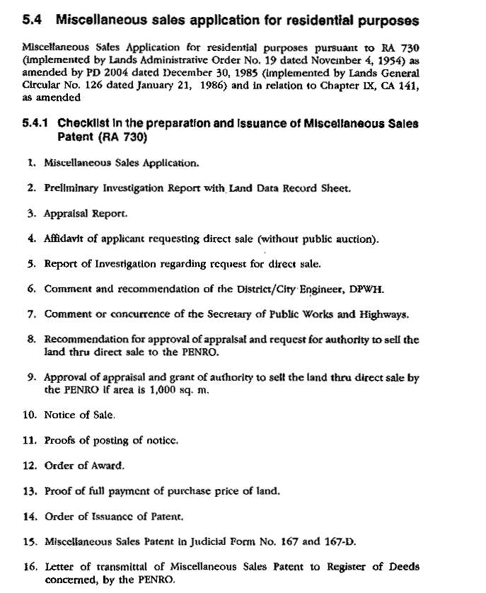
“AN ACT TO PERMIT THE SALE WITHOUT PUBLIC AUCTION OF PUBLIC LANDS OF THE REPUBLIC OF THE PHILIPPINES FOR RESIDENTIAL PURPOSES TO QUALIFIED APPLICANTS UNDER CERTAIN CONDITIONS” REPUBLIC ACT 730
Filipino Citizen
Of legal age
Does not own any home lot in the City or Municipality where the land applied for is located
Must have actually occupied in good faith the land applied for and constructed a house thereon where he/she is actually residing
The area of the land is not more than 1,000 square meters.
KNOWLEDGE
VALUATION
MAPPING
MANAGEMENT
REGISTRATION
TITLING
SURVEYING

Slide 43
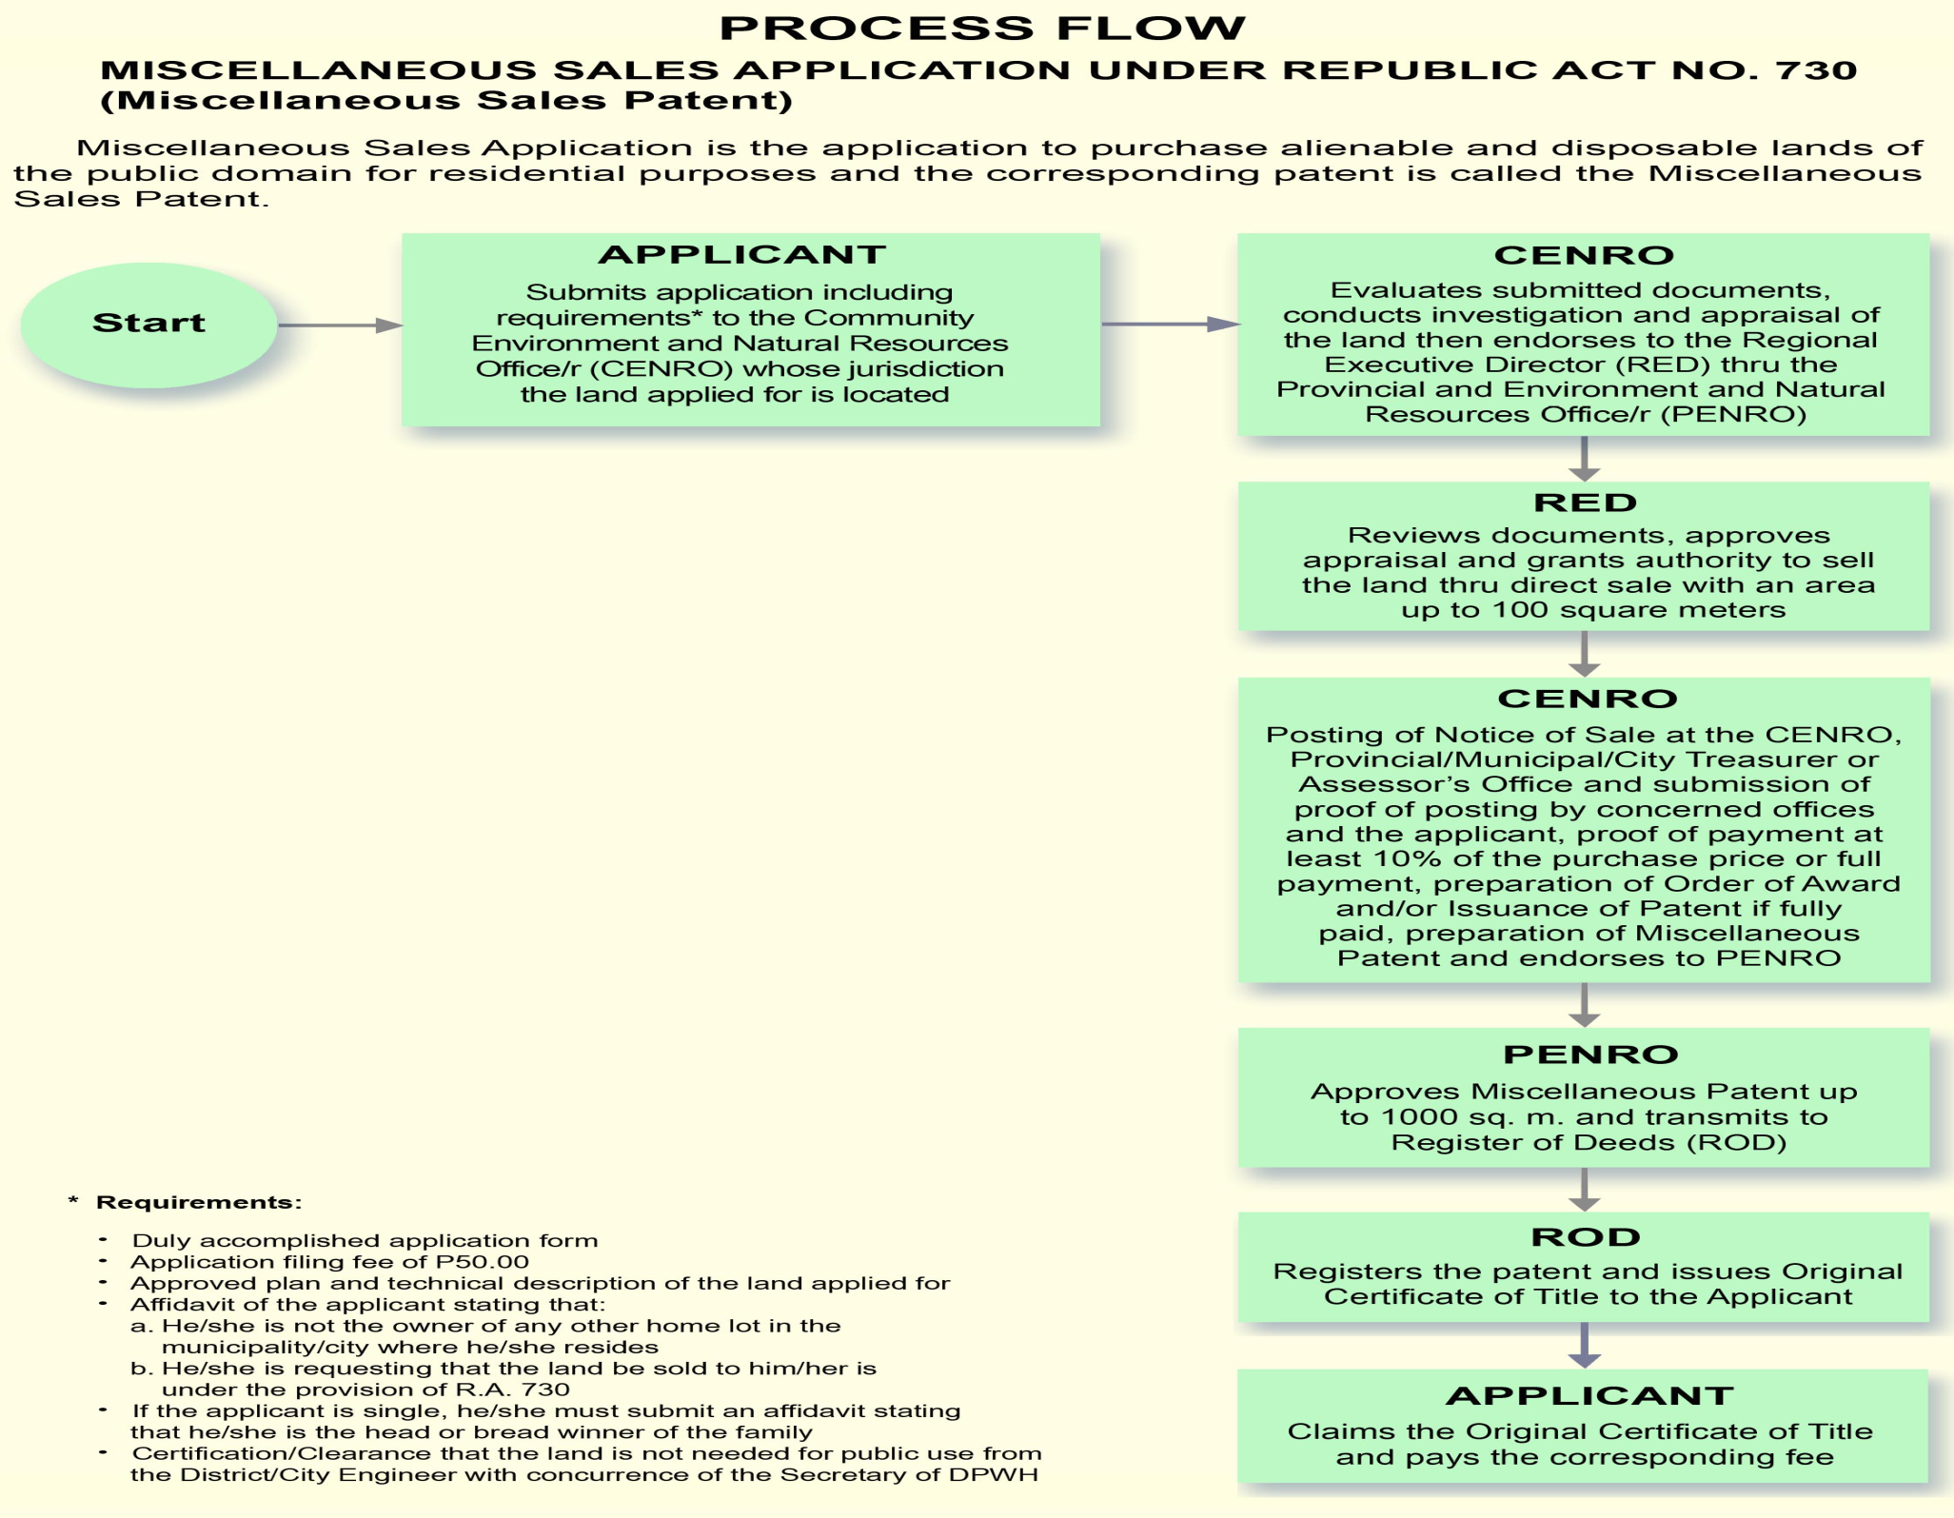

Slide 44
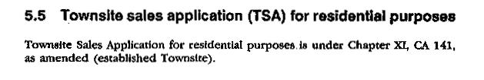
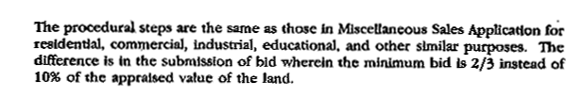
KNOWLEDGE
VALUATION
MAPPING
MANAGEMENT
REGISTRATION
TITLING
SURVEYING

Slide 45
SPECIAL PATENT
Q: What is a Special Patent:
A: It is a patent issued to grant , cede and convey in full ownership alienable and disposable lands of the government upon promulgation of a special law or act of Congress or a proclamation by the President of the Republic, authorizing the Secretary of Environment and Natural Resources to issue such patent.
Q: Who may Qualify to Apply?
A: Any Filipino citizen of legal age, or any government
corporation, province, municipality or other branches/
subdivisions of the government.
KNOWLEDGE
VALUATION
MAPPING
MANAGEMENT
REGISTRATION
TITLING
SURVEYING

Slide 46
Requirements in the Issuance of Special Patent
1. Formal/official request for the issuance of a Special Patent
2. Approved plan & technical descriptions of the land being applied for
3. Copy of the Executive Order, Presidential Proclamation or Special Law authorizing the issuance of a Special Patent or Deed of Sale / Conveyance or other Contracts conveying ownership of land duly approved
4. Comments and recommendations of the RED/RTD concerned
KNOWLEDGE
VALUATION
MAPPING
MANAGEMENT
REGISTRATION
TITLING
SURVEYING
5. Completed Staff Work (CSW)

Slide 47
Q: What are the Steps in Processing a Special Patent?
A: 1. Survey of the land applied for;
2. Filing of request/application for a special patent;
3. Evaluation and review of the documents submitted by the RED or RTD;
4. Endorsement of the request for the issuance of a special patent by the RED/RTD concerned to the Secretary, DENR, thru the LMB Director;
Note:
In the case of an individual applicant, the investigation, appraisal reports, approval of appraisal and payment of the purchase price thereof are duly evaluated before submission to the DENR Secretary thru the LMB Director.
KNOWLEDGE
VALUATION
MAPPING
MANAGEMENT
REGISTRATION
TITLING
SURVEYING

Slide 48
5. Refer to the Geodetic Surveys Division, LMB for verification and validation of the approved plan and technical description of the land applied for;
6. Preparation of the Special Patent
7. Transmittal of the prepared special patent to the DENR Secretary for his approval and signature.
Special Patent is signed by the President or by the DENR Secretary when authorized by law or proclamation.
KNOWLEDGE
VALUATION
MAPPING
MANAGEMENT
REGISTRATION
TITLING
SURVEYING

Slide 49
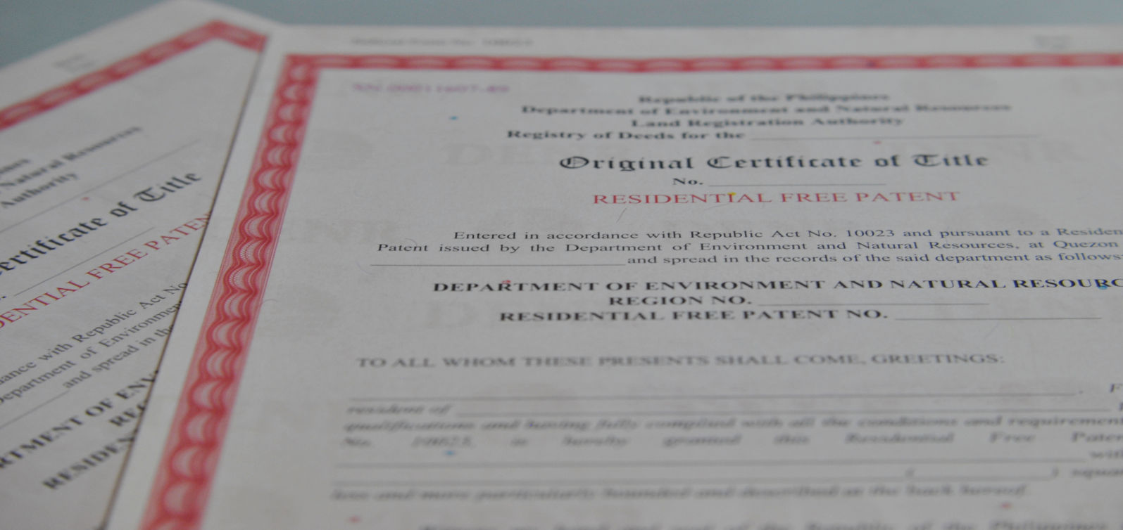
REPUBLIC ACT NO. 10023 (RESIDENTIAL FREE PATENT)

Slide 50
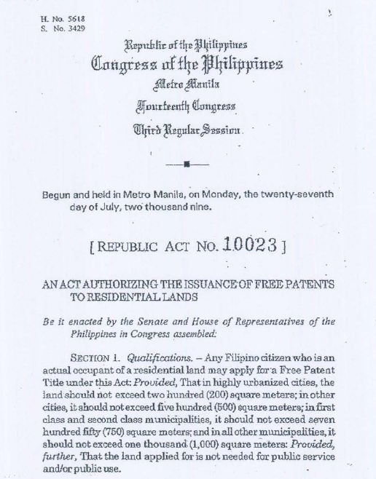

Slide 51
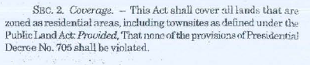
Coverage
Untitled residential lands
Townsite areas;
Delisted and abandoned military camps/reservations within zoned residential areas
Public schools, municipal halls, public plazas or parks, and other government institutions for public purpose- special patents located in public lands;

Slide 52
Modes of Disposition
Free Patents = untitled residential lands, town sites and delisted military camps (in zoned residential areas);
Special Patents = public schools, public parks, municipal halls and other government properties/assets in public lands
public use or public purposes

Slide 53
Criteria for Residential FPs (1)
Filipino citizen (natural-born and naturalised)
(As per DAO-2010-12 – IRR of RA10023)

Slide 54
Criteria for Residential FPs (2)
Actually resided on and continuously possessed and occupied for at least 10 years
No age limit;
Patent subject to constitutional limits on total lands acquired = 12 hectares
riteria for Residential FPs

Slide 55
Limits of Areas for Residential FPs
Highly-urbanised cities = 200 sqm
Other cities = 500 sqm
1st -2nd class municipalities = 750 sqm
all other municipalities = 1,000 sqm
land is not needed for public service/use
zoned as residential areas (by LGU) and conforming to PD 705 (Forestry Code);
delisted camps/townsites =zoned residential prior to NIPAs Law

Slide 56
Documentary Requirements
Affidavit of two disinterested persons confirming 10 year occupancy
Application should be supported by a map based on actual survey (either cadastral or other types of survey) by licensed GE approved by the DENR
Map should contain both technical and physical description
Zoned residential area by LGU (certification from city/municipal planning office or zoning ordinance)

Slide 58
Processing of FP Applications
Applications at the CENRO level- to be processed within 120 days including notices
Forward to PENRO
PENRO must act within 5 days

Slide 59
Restrictions for Residential FPs
NONE :
Land can be immediately used for commerce or financial lending services

Slide 60
The Agricultural Free Patent Reform Act of 2019 or R.A. 11231 (effective March 2019) removes the restrictions on agricultural free patents under Commonwealth Act (C.A.) No. 141 or Public Land Act of 1936. The restrictions removed by the law are as follows:
-->Five (5) year prohibition on encumbrance and alienation (Sec. 118 of C.A. 141);
--->Five (5) year right to repurchase (Sec. 119 of C.A. 141), and
--->Prohibition on corporation, association, or partnership to acquire or own an agricultural free patent (Sec. 121 of C.A. 141).

Slide 61
Restrictions of Special Patents (1)
Patents issued under the name of DepEd (for public schools), LGU (for municipal halls, public plazas or parks) and concerned agency (for other government institutions)
Used for public service or public use (DAO 2010-12)

Slide 62

Restrictions of Special Patents (2)
Cannot be disposed/sold or (leased) without authority from Congress if NGA or the Sanggunian through an ordinance if LGU property

Slide 63
Process Flow
Accomplish application form and documentary requirements
Processing in CENRO
Approval in PENRO
Registration in Registry of Deeds

Slide 64
Application
Copy of DENR approved Plan
Copy of technical description
Processing at the CENRO
Application form with complete attachments
A and d certification
Simplified sketch
Two affidavits of disinterested person
Certification of no pending land registration proceedings from the RTC
Certification fro LGU that land is not needed for public use/purpose
Zoning ordinance/zoning certification from LGU
Posting and Certificate of posting
Investigation/ocular inspection and report
Order if Issuance of patent
Transmittal to PENRO
Approval at PENRO
Review and approval of Patent
Transmittal to Register of deeds
Registry of Deeds
Registration of Patent
Distribution to title owner

Slide 65
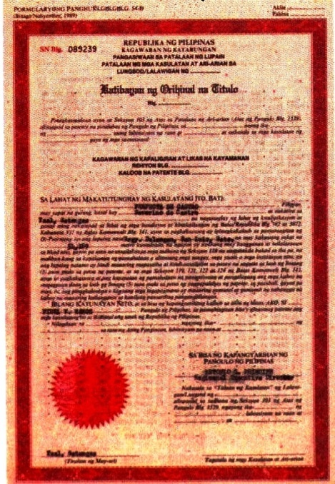
Disposition of Alienable and Disposable Public Lands
Land Classification
Geodetic Controls
Cadastral
Parcellary Surveys
Homestead
Free Patents/
RFP
Misc. Sales
Original Certificate
of Titles
Transfer Certificate
of Titles
Special Patents
CLOAs/EPs
Judicial Decrees
CADT/CALT
Survey and Mapping
Titling
Original Registration
Subsequent
Registration
DENR
DENR/DAR/NCIP
COURT/LRA
Register of Deeds
Register of Deeds

